Slide 1

Chapter 4
Strings

Slide 2
Content
What is a string
Function len
Characters
Loop over a string
Slicing
Compare strings
String methods

Slide 3
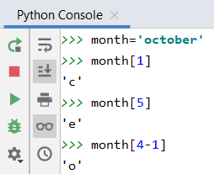
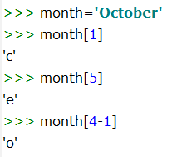
String
A string is a composite data type: consists of an ordered sequence of characters
The characters of the string can be reached via the index, which starts counting from 0.
Example:
month = 'October' or
month = "October"
month[2]
A string is ‘immutable’. This means: never write month[2]='p'
O | c | t | o | b | e | r
0 | 1 | 2 | 3 | 4 | 5 | 6

Slide 4
4 different delimitters for a string
keeper = ‘Thibaut Courtois’ # ‘
defender = “Jan Vertonghen” # “
midfielder = ‘’’Kevin De Bruyne’’’ # ‘’’ (triple ‘)
striker = “””Romelu Lukaku””” # ”””(triple”)
titel = “Harry Potter and the philosopher’s stone”
song = ‘‘’she said: “I think I’m in love.”’’’
This end of text problem can also be solved with an escape character ‘\’ (backslash)
which alters the meaning of the successive character. In this case the ‘ (or “)
song = ’she said: “I think I\’m in love.”’
song = “she said: \“I think I’m in love.\”” #alternative solution

Slide 5
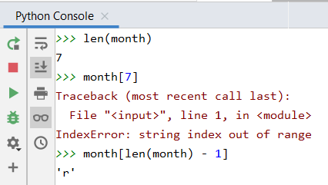
Length of a string
Built-in function len()
You pass the string as an argument: e.g. len(month)
The result indicates how many characters the string consists of
Note: a string with length 7 has 7 characters which are numbered 0 ... 6
O | c | t | o | b | e | r
0 | 1 | 2 | 3 | 4 | 5 | 6

Slide 6
Characters
Strings are an ordered sequence of characters
Each character is represented internally in binary form
Standardized character sets:
ANSI (American National Standards Institute)
ASCII (American Standard Code for Information Interchange)
Uses bytes
ASCII table links bytes to symbols
2 ⁷ | 2 ⁶ | 2 ⁵ | 2 ⁴ | 2 ³ | 2 ² | 2 ¹ | 2 ⁰
0 | 1 | 0 | 0 | 1 | 1 | 0 | 0
128 | 64 | 32 | 15 | 8 | 4 | 2 | 1
L

Slide 7
ASCII is a subset of Unicode
Python's string type uses the Unicode Standard for representing characters,
which lets Python programs work with all these different possible characters.
Unicode (https://www.unicode.org/) is a specification that aims to list every character used by human languages and gives each character its own unique code.
Python can use ASCII, UTF-8, UTF-16 and even UTF-32
ASCII is a 7-bit code
UTF-8 is a 8-bit code and supports the major part of western languages
UTF-16 or UTF-32 is needed to support Hebrew, Chinese, Arabic, etc…
It’s also used in communication between different systems (API)

Slide 8
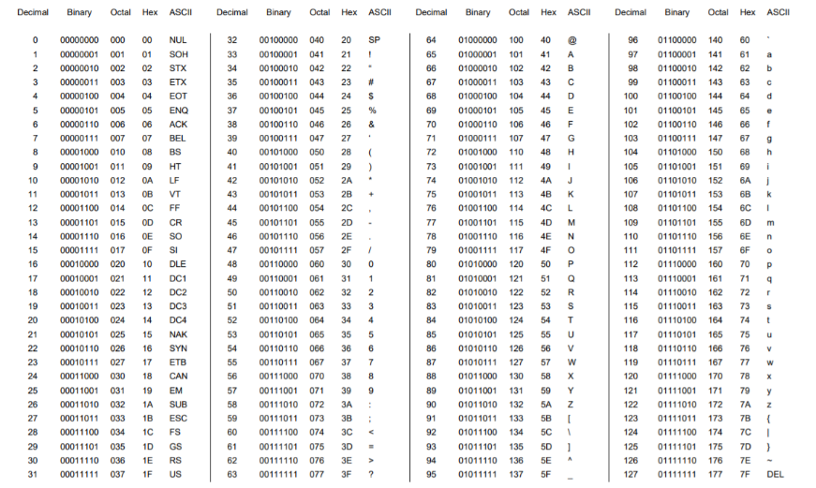
127 characters in the ASCII table
https://www.eecis.udel.edu/~amer/CISC651/ASCII-Conversion-Chart.pdf

Slide 9
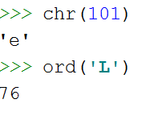


Characters
Built-in functions
ord() character to ASCII code (integer)
chr() ASCII code (integer) to character
ord() comes from "ordinal" (rangorde) → ord() returns the ordinal value of its argument.
Example 1: print every character of the alphabet
start = ord('a') for i in range(26): print(chr(start + i) + ' ', end='')

Slide 10
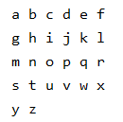
Characters
Example 2: printing all characters of the alphabet 6 by 6
i%6 You calculate the rest by dividing by 6 and that is 0, 1, 2, 3, 4 or 5. As soon as the rest = 5, you go to a new line using print()
start = ord('a') for i in range(26): print(chr(start + i) + ' ', end='') if i % 6 == 5: print()

Slide 11
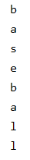
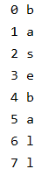
Loop over the characters of a string
Example 1: while
Example 2: for loop with range
Example 3: for loop
sport = "baseball" i = 0 while i < len(sport): print(sport[i]) i += 1
sport = "baseball" for letter in sport: print(letter)
sport = "baseball" for i in range(len(sport)): print(i, sport[i])

Slide 12
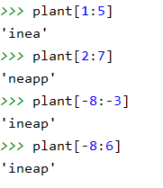
Slicing
When you need a part of a string, you use slicing.
name_string[start:end] (note: character at the end is NOT included)
Example:
plant = 'pineapple'
0 | 1 | 2 | 3 | 4 | 5 | 6 | 7 | 8
p | i | n | e | a | p | p | l | e
-9 | -8 | -7 | -6 | -5 | -4 | -3 | -2 | -1

Slide 13
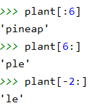
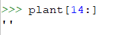
Slicing
name_string[start:end]
from the beginning of the string if start is empty
until the end of the string when end is empty
Note: you will not get an error if you go beyond the limits of the string:
0 | 1 | 2 | 3 | 4 | 5 | 6 | 7 | 8
p | i | n | e | a | p | p | l | e
-9 | -8 | -7 | -6 | -5 | -4 | -3 | -2 | -1

Slide 14
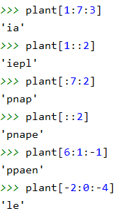
Slicing
Slicing operator can also be done with 3 parameters:
name_string[start:end:jump_size]
0 | 1 | 2 | 3 | 4 | 5 | 6 | 7 | 8
p | i | n | e | a | p | p | l | e
-9 | -8 | -7 | -6 | -5 | -4 | -3 | -2 | -1

Slide 15
Quiz
word = 'mystery'
word[2]
word[2:]
word[:2]
word[2:2]
word[::2]
word[-2]
word[-2:]
word[:-2]
word[::-2]
word[-2::-2]
word[::-1]

Slide 16
Quiz: solutions
word = 'mystery'
word[2]
word[2:]
word[:2]
word[2:2]
word[::2]
word[-2]
word[-2:]
word[:-2]
word[::-2]
word[-2::-2]
word[::-1]
's'
'stery'
'my'
''
'msey'
'r'
'ry'
'myste'
'yesm'
'rty'
'yretsym'

Slide 17
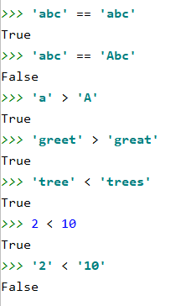
Compare strings
Strings are compared character by character according to the ASCII table
Examples:
The number 2 is smaller than the number 10
If we compare them as strings, the character '2' is 'bigger' than the character '1'

Slide 18
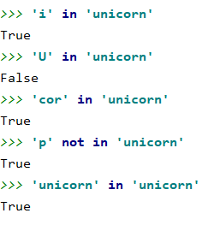
Compare strings: operator (not) in
The operator in checks whether the first string is part of the second string
Examples:
A string is a substring of itself

Slide 19

Strings: program example
Turn a sentence with punctuation marks into a sentence without punctuation marks
punctuation_marks = ',.:;?!' sentence = input('Enter a sentence with punctuation marks: ') sentence_without = '' for character in sentence: if character not in punctuation_marks: sentence_without += character print('The sentence without punctuation marks:', sentence_without)

Slide 20
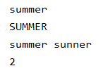
String methods
Method = function linked to a certain object
Notation: name_object.name_method(parameters)
String methods return a new string, the original string remains unchanged
season = "summer" season.capitalize() print(season) print(season.upper())
new_season = season.replace('m','n') print(season, new_season) print(season.count('m'))

Slide 21
String methods
name | functionality | example | result
capitalize | convert first letter to uppercase letter | "python".capitalize() | Python
lower | convert all letters to lowercase | 'IT Factory'.lower() | it factory
upper | convert all letters to uppercase | 'IT Factory'.upper() | IT FACTORY
strip | remove leading and trailing whitespace (spaces, tabs, line breaks, ...) | ' a b '.strip() | 'a b'
lstrip | remove leading whitespace | ' a b '.lstrip() | 'a b '
rstrip | remove trailing whitespace | ' a b '.rstrip() | ' a b'
count | count how often one string occurs within another string | "cucumber".count("cu") | 2
find | look up the position where a string occurs for the first time within another string (-1 if no occurrences found) | 'python'.find('ho') 'python'.find('is') | 3 -1
replace | replace all occurrences of one string with another string | 'python'.replace('yth','o') | 'poon'

Slide 22
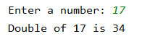
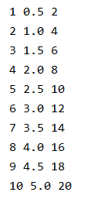
String methods: format
Format is a string method that takes care of the formatting of the text
number = int(input('Enter a number: ')) print('Double of {} is {}'.format(number, number * 2))
for number in range(1,11): print('{} {} {}'.format(number, number / 2, number * 2))

Slide 23
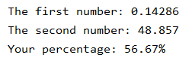
String methods: format
Float formatting:
An overview of the possibilities can be found at: https://docs.python.org/3/library/string.html#formatstrings.
number1 = 1/7 number2 = 342/7 score = 17/30 print('The first number: {:.5}'.format(number1)) print('The second number: {:.5}'.format(number2)) print('Your percentage: {:.2%}'.format(score))

Slide 24
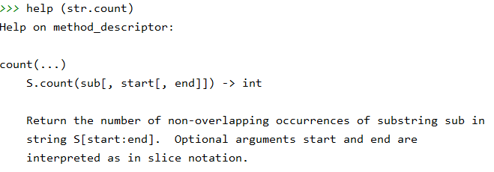
String methods
Where can you find information about a string method?
For an overview:
https://docs.python.org/3/library/stdtypes.html#string-methods

Slide 25
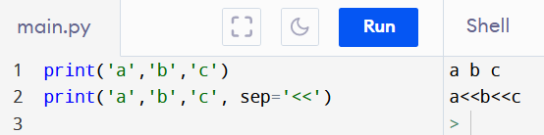
A more complete print function
print(*objects, sep=‘ ‘, end=‘\n’) # (there are more optional parameters)
You can print one or more objects in a collection
All objects are automatically converted to a string
If * is used before a collection:
the brackets and commas are removed before printing
The different strings are standard separated by one ‘ ‘
this can be modified with the optional keyword argument sep
example: sep=‘<<‘
Standard the cursor will jump tot the next line after the print
end=‘\n’ → \n is the newline character and \t is a tab character
end=‘\t’ gives a tab after each print() operation, but the cursor wil stay on the same line
# https://docs.python.org/3/library/functions.html#print

